Slide 1
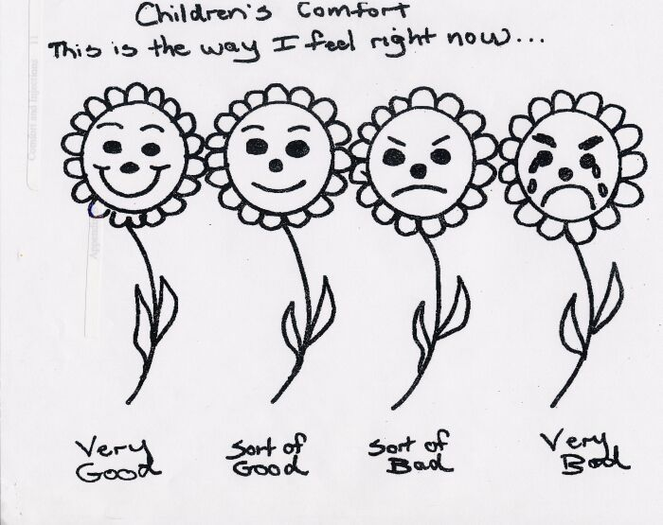
Comfort Daisies-Revised Pediatric Measurement of Comfort

